Slide 1
Web-based Simulation Platform
Supervisor: Professor Wainer
Group Number: 50
By: Tyler Mak (101108389) and Andy Ngo (101132278)
Notes:
Motivation: why?
Goal: what?
Contributions: how?
Make it flow better, think of how to say it first then update the slide order

Slide 2
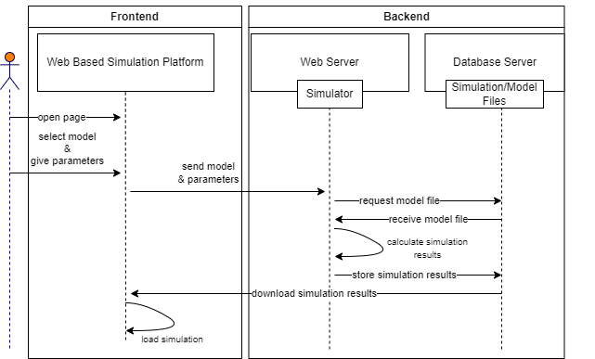
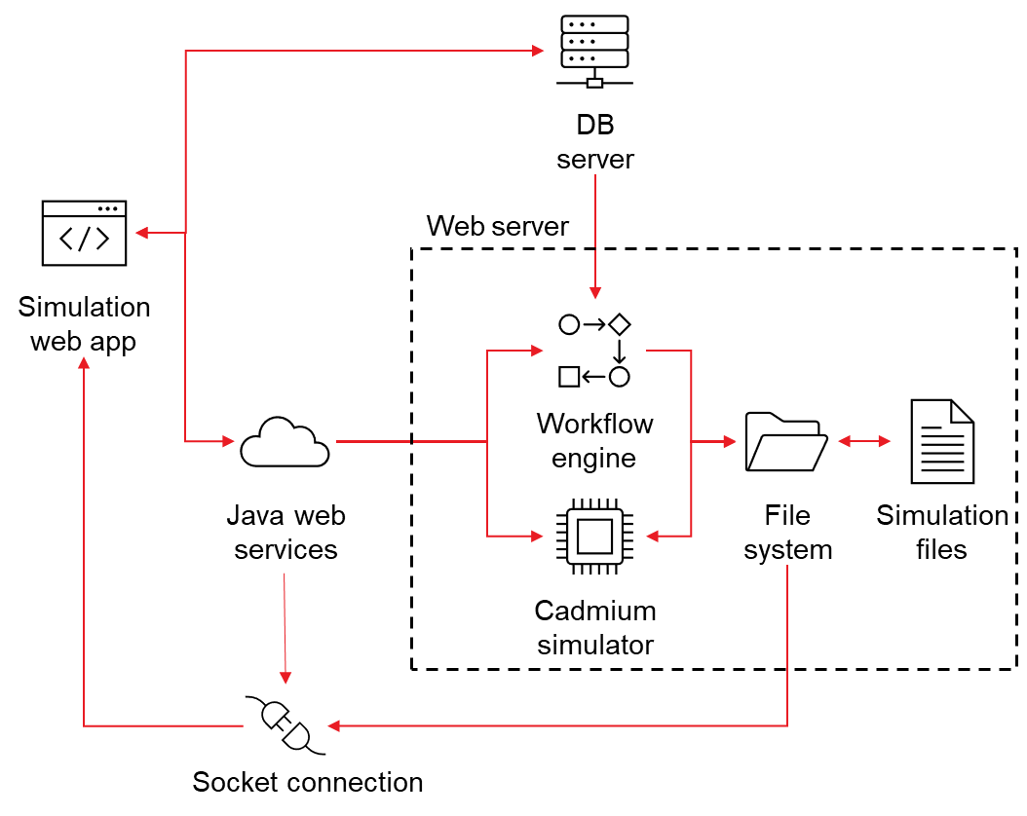
Architecture
Notes:
Explain the contributions, show through workflow diagram
Present workflow and planned work flow
Each frame sends out one plot
Communication diagram for data flow
Architecture diagram,
Communication diagram: the old dataflow,
Send the model/parameters for the cadmium simulator to access the database server
Cadmium was the previous simulation system used
Get the model file and will calculate the simulation results and store it as a log file in the database server
Db server will send the log file to the frontend web based simulation platform
the frontend of the system used to download the simulation results before loading the simulation

Slide 3
Introduction
Motivation:
Not many web-based simulation platforms that are optimized
Goal:
Create a web-based simulation
Easier to access
Improve user experience
Make it more efficient
Contributions:
Implemented Websockets
Implemented webworkers
Implemented visualization
Notes:
Briefly talk about the original state of the project?
Go over the current state of the project

Slide 4
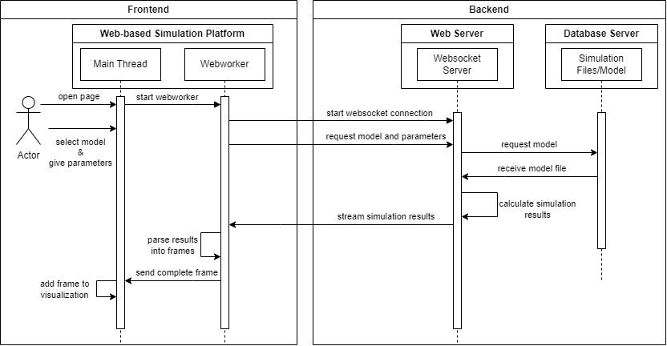
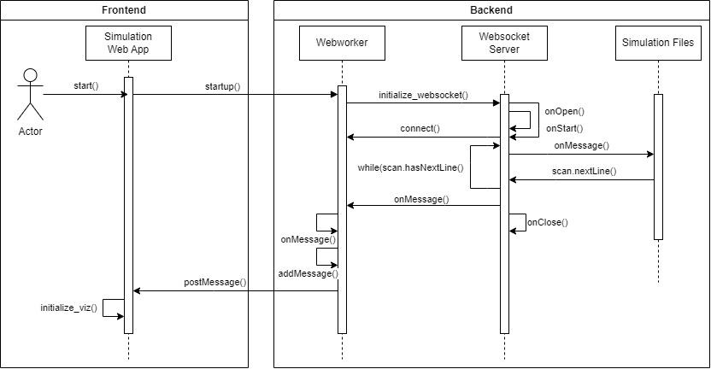
Communication Diagram

Slide 5
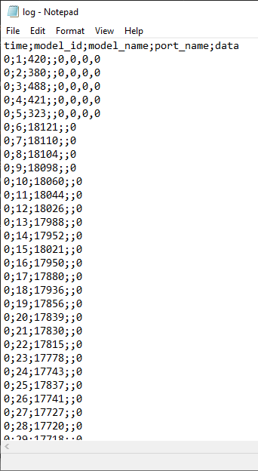
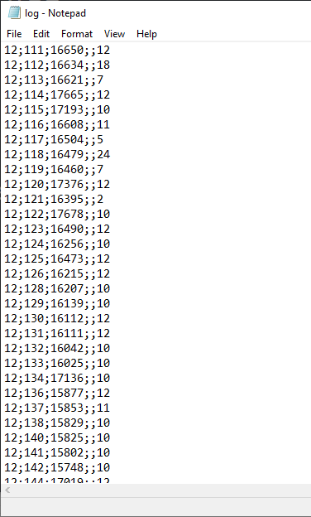
Message Log Files
Log files contain:
State Messages
Output Messages
Time Frame
Notes:
Cover what the log files contain and how they will be used
Log files will be used to load onto the simulation as time frames,

Slide 6
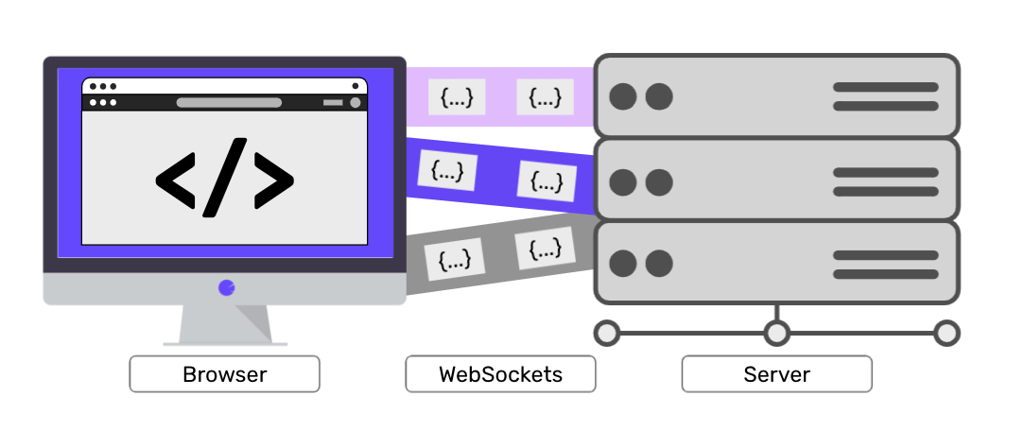
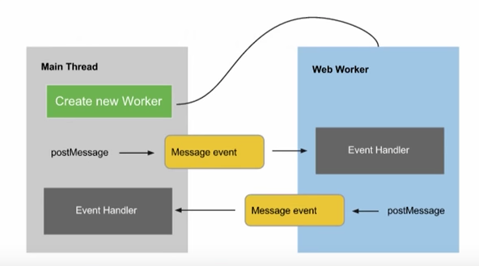
Technology used
Websocket:
Allows the client and server to communicate simultaneously
Webworker:
Background thread
Notes:
REST architecture was being used before, which was a one way communication. With websocket it allows the browser and server to communicate at the same time.
Webworker will be used because it will be used as a background thread to read through the model file and send each time frame to be visualized

Slide 7
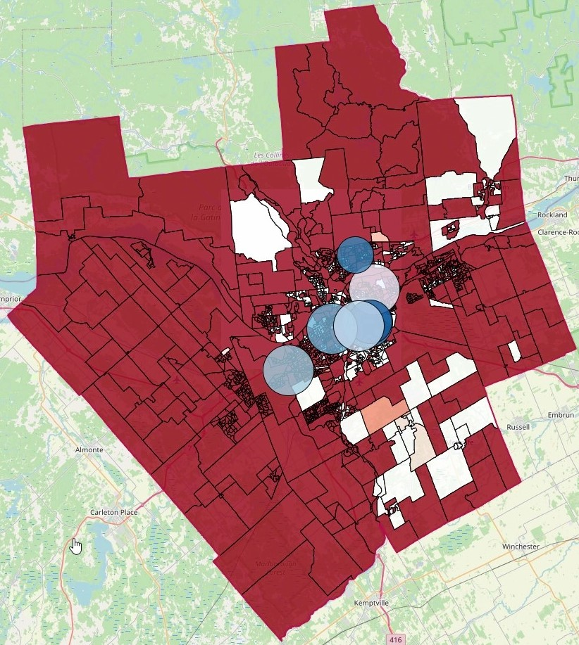
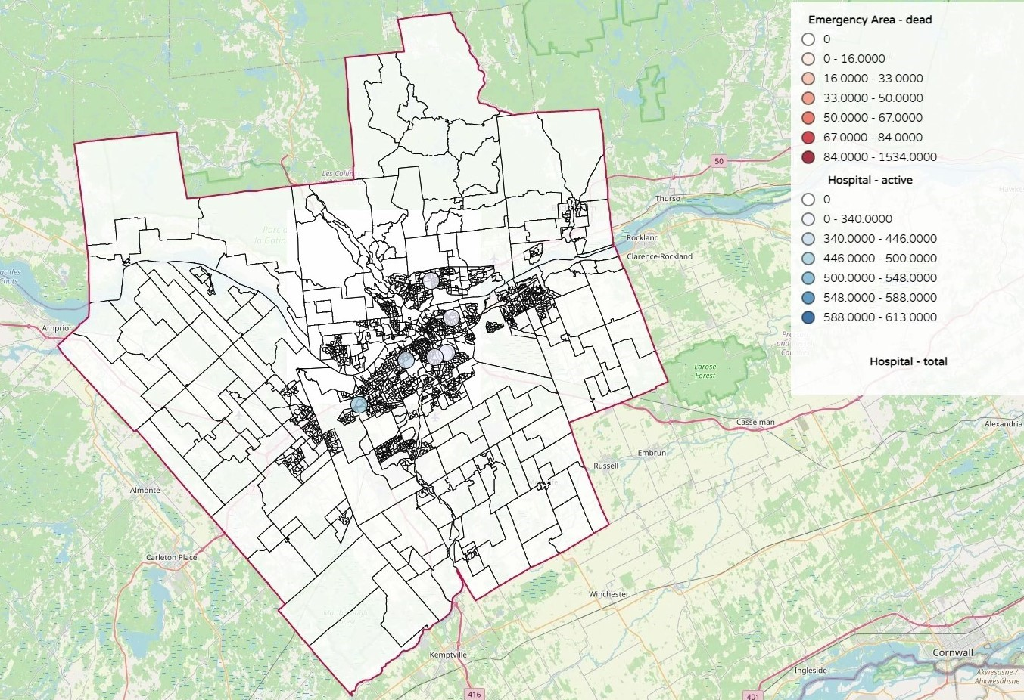
Visualization
Notes:
This simulation example is a map of Ottawa simulating number of emergency cases and occupied hospitals.
The darker the shade of red indicates more reports of death cases
The blue circles indicate the hospitals and the bigger the circles are indicate a certain amount people

Slide 8
Conclusion
Results send faster using websocket and webworkers
Webworker will process through the simulation file to visualize onto a map
Future Plans:
Implement interactive simulation
Allow user to pause, adjust parameters and resume the simulation
Websocket connection between front and backend used for streaming simulation results as they generate
Add more tasks for webworker

